Slide 1



APACHE SPARK DEEP DIVE Cache Vs Persist With Spark UI

Slide 2

Cache Vs Persist
Cache() = Persist(StorageLevel. MEMORY_ONLY)

Slide 3

Cache Vs Persist
The difference between cache() and persist() is that using cache() the default storage level is MEMORY_ONLY while using persist() we can use various storage levels :
a. MEMORY_ONLY
In this storage level, RDD is stored as deserialized Java object in the JVM.
b. MEMORY_AND_DISK
In this level, RDD is stored as deserialized Java object in the JVM memory and disk.
c. MEMORY_ONLY_SER
This level of Spark store the RDD as serialized Java object (one-byte array per partition).
d. MEMORY_AND_DISK_SER
It is similar to MEMORY_ONLY_SER, but it drops the partition that does not fits into memory to disk.
e. DISK_ONLY
In this storage level, RDD is stored only on disk.

Slide 4
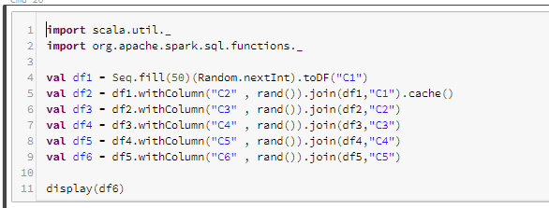

Cache Vs Persist
Let’s see it with an example and validate the same on Spark UI

Slide 5
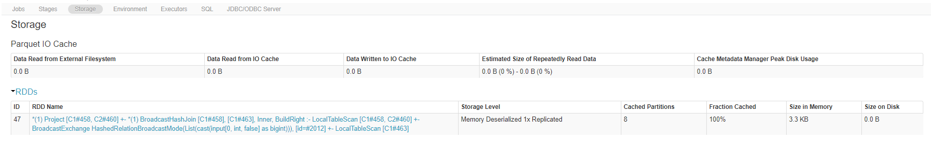

Cache Vs Persist

Slide 6
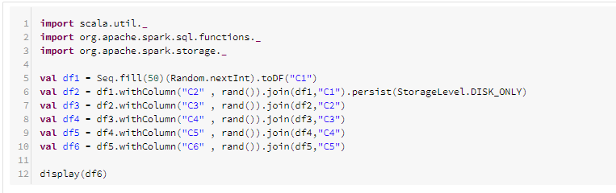

Cache Vs Persist
Change the code to use Persist

Slide 7
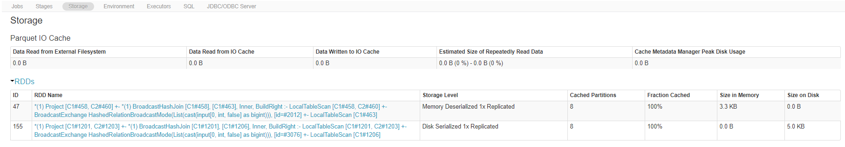

Cache Vs Persist

Slide 8
Cache Vs Persist
Thanks and do subscribe to my channel

